Slide 1



AUGMENTED REALITY
WATCH VIRTUAL TRY ON

Slide 2
OVERVIEW
In our application, we aim to elevate user experience by seamlessly integrating virtual elements into live video streams captured through a laptop webcam.
The core functionality revolves around wrist detection and tracking, achieved through the utilization of the powerful Mediapipe library.
By harnessing the capabilities of Flask API, Python scripting, and real-time image processing, we introduce a captivating feature—a virtual watch overlay.

Slide 3
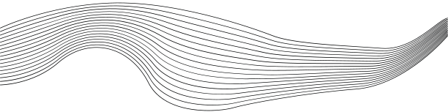
TECH STACK
01
PYTHON - MEDIAPIPE
02
PYTHON - FLASK
03
HTML
04
CSS
05
JAVASCRIPT

Slide 4
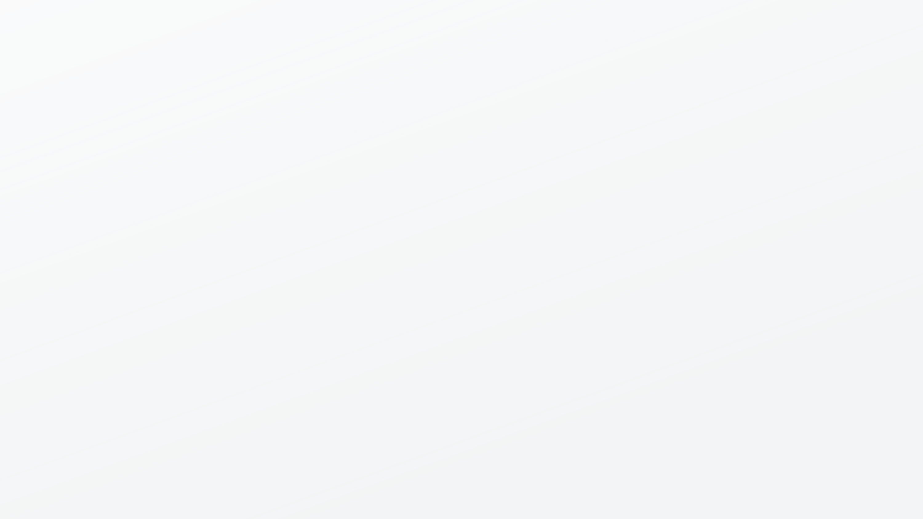
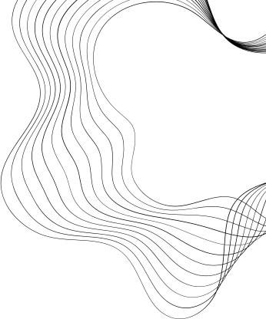
SYSTEM ARCHITECTURE
Flask API handling requests and responses
Python Script processing frames using Mediapipe
Frontend displaying the processed frames
Laptop Webcam capturing video frames
WEB APP
WEB APP
PYTHON

Slide 5

WORKING
Webcam captures video frames.
Frames sent as requests to Flask API.
Python script processes frames using Mediapipe for wrist detection.
Wrist tracking is perform and suitable rotation matrix is created.
Virtual watch image is overlaid on the detected wrist.
Processed frames sent to the frontend.

Slide 6


USE CASES
Online shopping
Software as a Service
METAVERSE

Slide 7
FUTURE SCOPE
In future our “Augmented Reality Watch Try-on Application” dataset and scope will be scalable.
The user might not only be able to try out different watch models but they can also try out this application by trying on garments, goggles, foot wears etc.
It can also be used for various applications like in shopping malls, interior designing etc.

Slide 8

THANK YOU

